Slide 1





Welcome to the Tollgate Christmas Performance!
Keep your children safe whatever is wrapped underneath the Christmas tree!

Slide 2
The following slides contain advice, guides and website links which will help you and your family have a very happy and safe Christmas holiday.
It will be uploaded to the school website if you want to take another look later.

Slide 3
The 20:20:20 rule
To guard against possible eye damage, encourage your child to look away from their screen every 20 minutes, for 20 seconds and focus on something 20 feet (6 metres) away.

Slide 4
Don’t overuse technology
At a time when excitement and emotions are already running high, technology can stimulate the brain to exacerbate these feelings. Make sure your child has regular breaks from their screen.

Slide 5

Keep devices where you can see them
It’s a good idea to keep devices in a central room in your home so that you are able to keep an eye on what your child is doing online and offer support if they need it or simply show an interest in what they are doing.

Slide 6


Some of the following guides are about games rated for older children than we have at Tollgate but just in case…
These guides have all been “Pinged” out but please let us know if you would like a printed copy of any of them.

Slide 7
Why is it so important that your child only accesses age appropriate content?

Slide 8
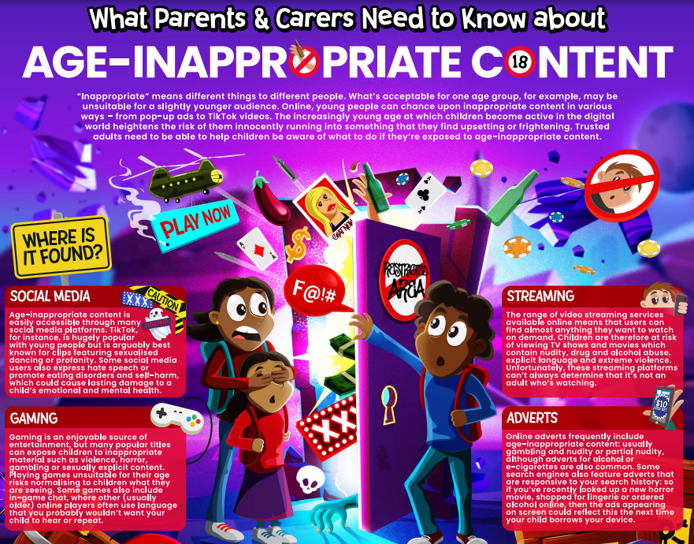

Slide 9

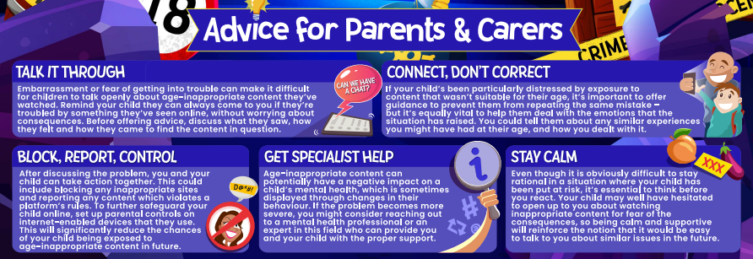

Slide 10
Understanding the Amazon Fire
and
Google Chromebook

Slide 11
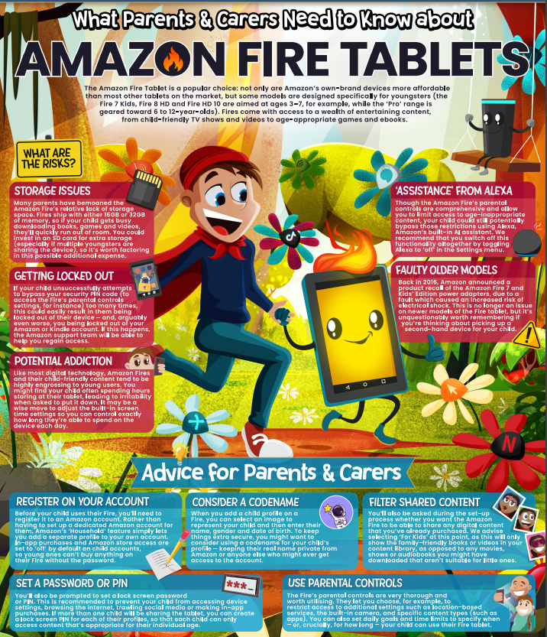

Slide 12
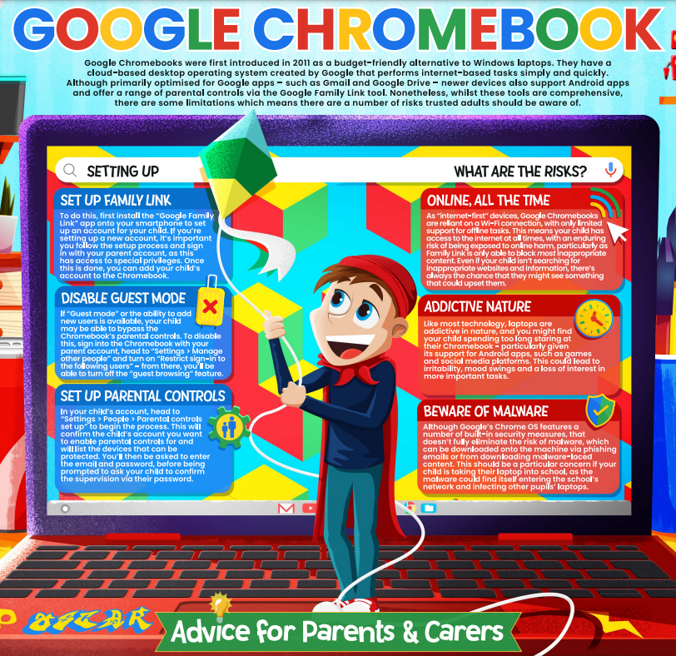

Slide 13
Protecting your child from
Online Bullying

Slide 14
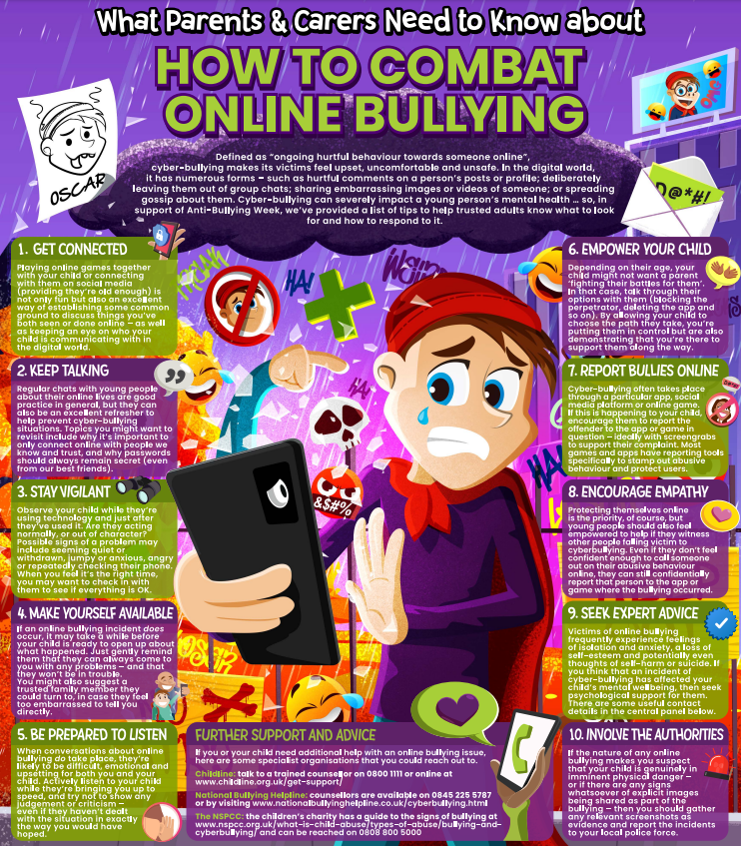

Slide 15
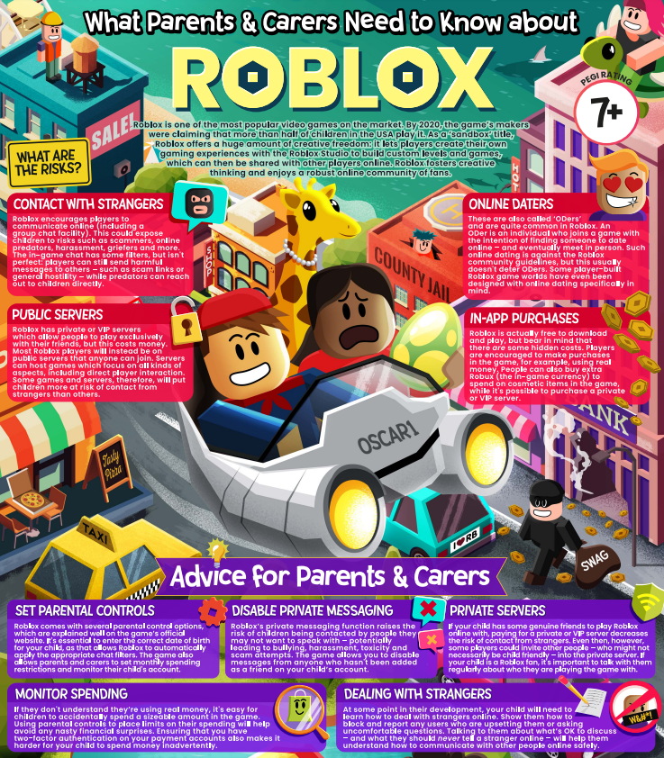

Slide 16
Advice on some of the more popular online games and social media…

Slide 17


Slide 18
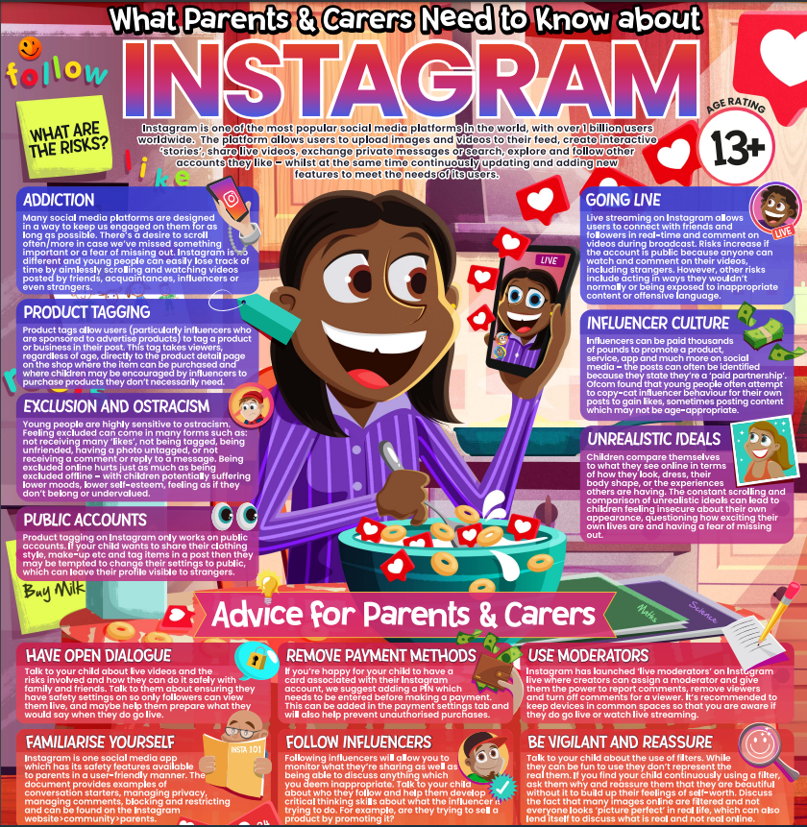

Slide 19
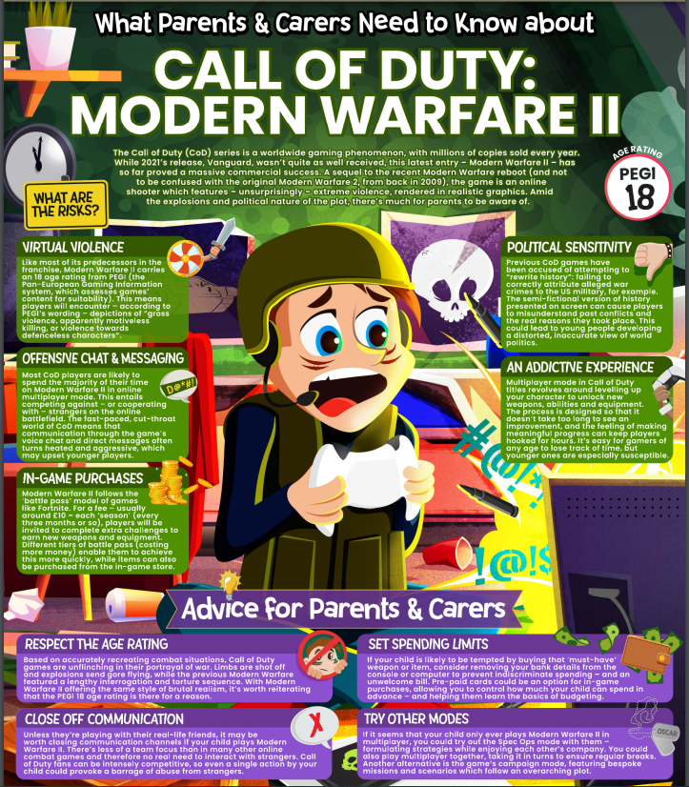

Slide 20
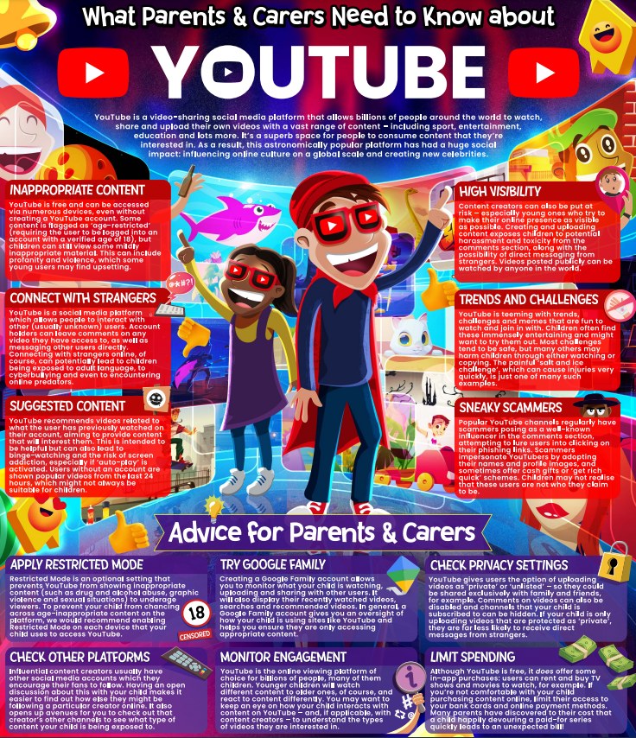

Slide 21
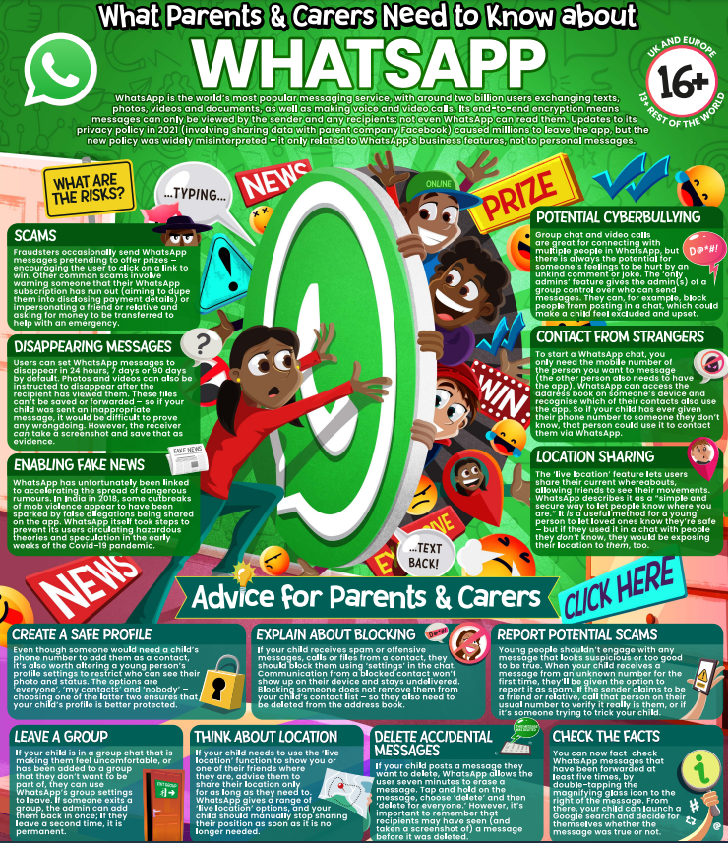

Slide 22
Make your use of technology as green as your Christmas tree!

Slide 23
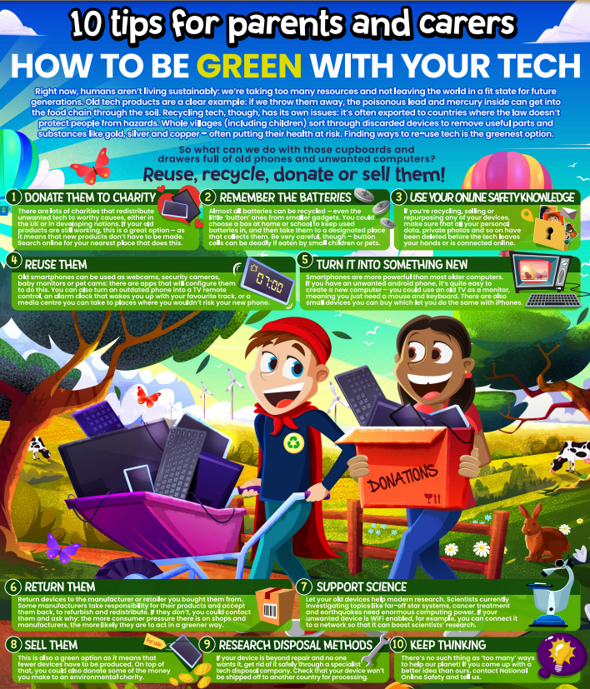

Slide 24
Is your child getting a new digital device for Christmas? Have you set it up with parental controls to keep them safe?
Parental Controls can:
Protect your child from inappropriate content
Protect your child from contact with strangers
Limit the amount of time a child can have online without causing an argument.

Slide 25
Unsure how to set up parental controls?
There are many website guides which can help (depending on the device) including…
https://www.connectsafely.org/controls/
https://www.internetmatters.org/parental-controls/
https://www.nspcc.org.uk/keeping-children-safe/online-safety/parental-controls/
https://support.google.com/googleplay/answer/1075738?hl=en-GB
(This list is available on our school website)

Slide 26
All that remains is for us to wish you
a very merry and very safe Christmas!

